Slide 1
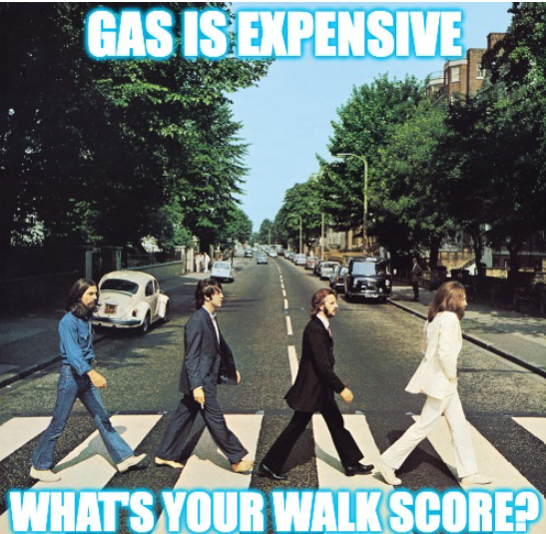
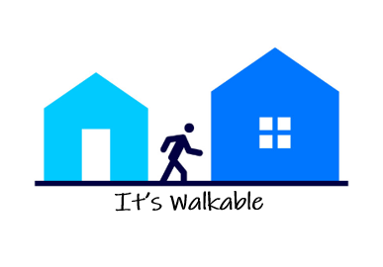
Is there a relationship between house prices and walk score?
CS 797Q
Applied and Practical Data Science
By:
Purva Natoo - R644J946​
Curtis Martin - E252H926​
Francisco Javier Rafful Garfias - Z367M789
Sriram Srinivasan - E334W844​
Vijay Ram - F448J755​
Sai Chandana Kondamadugula - N897P533
Group #: 5

Slide 2
Introduction
FOCUS
Correlation between neighborhood's walkability and house prices.
WALKABILITY
Walking distance from that address to a variety of key services.​ A higher walk score is a better walk score.
KEY POINTS IN HOUSING MARKET
Crime, Housing supply, Air Pollution, etc.
BENEFITS
Health, Economic, Social, and Environmental benefits. ​

Slide 3
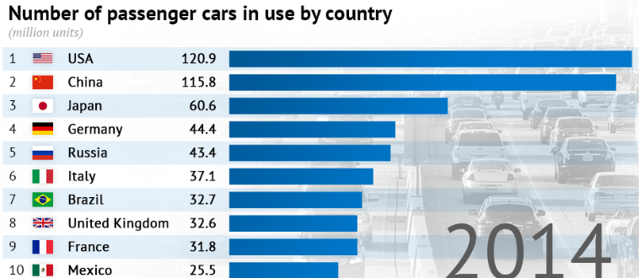
Background
USA is primarily a car-based nation, impossible to survive if one doesn't live in big metro cities such as Philadelphia, NYC, Chicago.
We wanted to see if having amenities such as grocery store, post office, etc. within a reasonable walking distance help drive up/down housing prices.

Slide 4



Research Question
An increase in neighborhood´s walkability will lead to an increase in house prices in absence of other factors.​

Slide 5

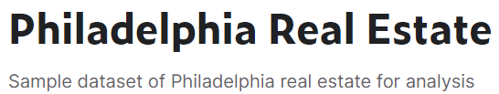
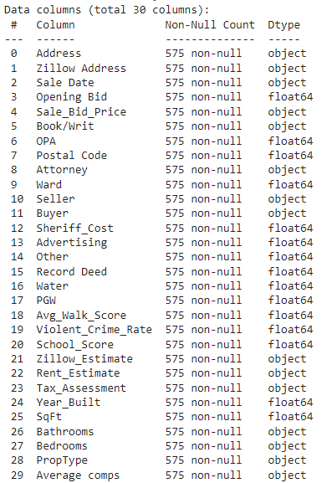
Methodology
Dataset
Publicly available dataset from Kaggle called “Philadelphia Real Estate”.
Has data for real estates in Philadelphia.
Has features like Zillow estimate(price), crime rates, school scores, walk scores, etc., for each real estate property.
Dataset is 57KB in size.

Slide 6
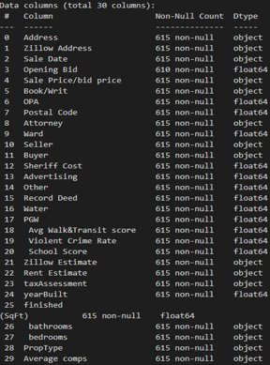
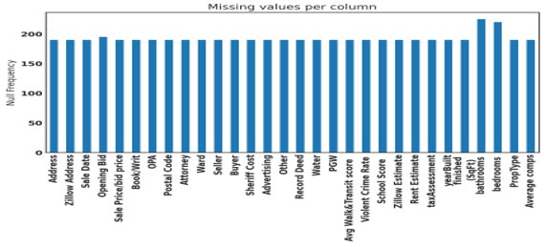
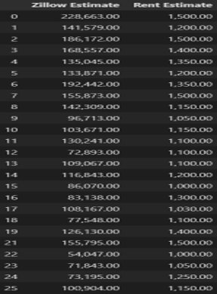
Methodology
Data Cleaning
Checked datatype of all variables
Checked for missing values
Removed invalid characters

Slide 7
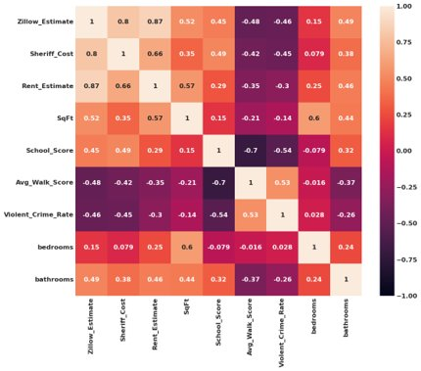
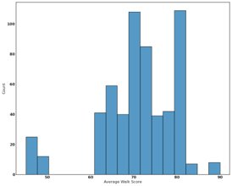
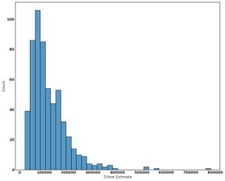
Methodology
Data Visualization
Heat Map
Distribution of independent variable
Distribution of dependent variable

Slide 8
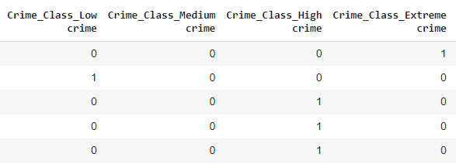

Methodology
Feature Engineering
Binning –
Average Walk Score, Violent Crime Rate​
One Hot Encoding –
Average Walk Score, Violent Crime Rate​
MinMax Scaling of Data–
Normalized the data​

Slide 9
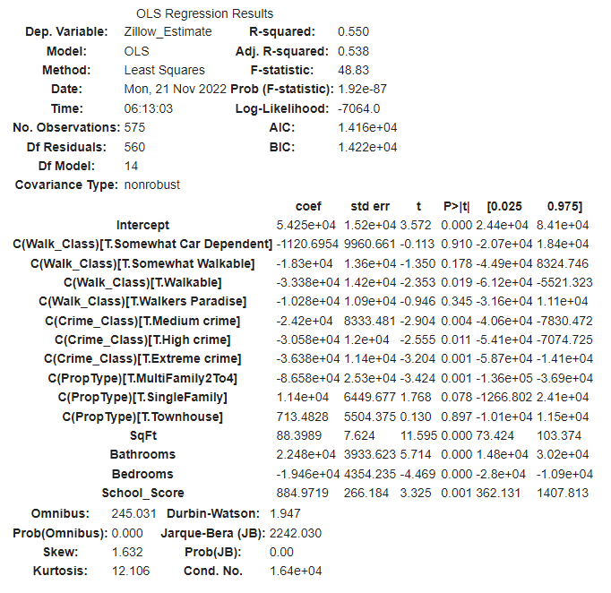
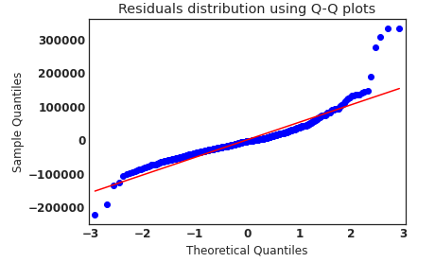
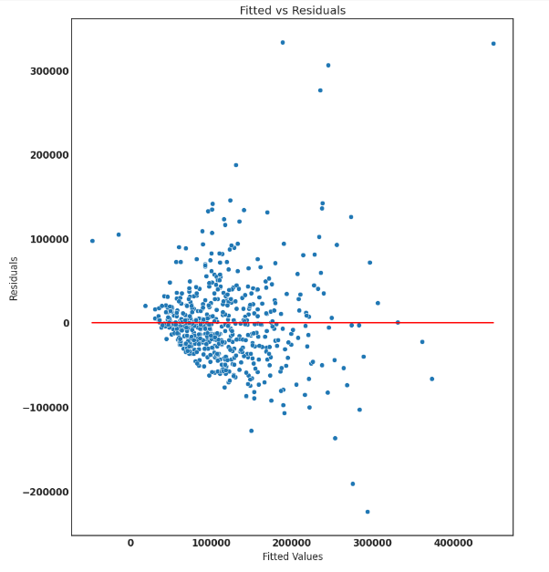
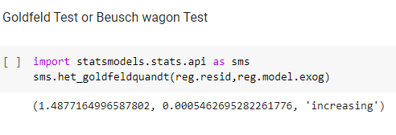
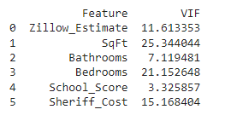
Methodology
Statistical Analysis
Normality
Linearity
Homoscedasticity
Multicollinearity
Used OLS Regression to understand statistical significance of ​ various features.
Statistical Analysis suggested use of Lasso Regression as a machine learning model.
Performed various tests to check if linearity assumptions hold.
All assumptions except multicollinearity assumption hold true for the used data.

Slide 10


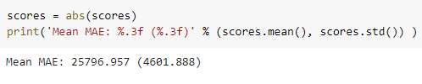
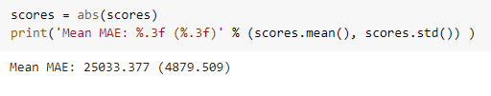
Methodology
Machine Learning Model
Regression
Compared multiple regression algorithms using Mean Absolute Error as criteria.
Used K-fold Grid Search to fine tune parameters (k=5)​
Our best model is random forest regression (max depth = 200) with a MAE of 20991 on our testing data.
Support Vector Regression
Lasso Regression
Extreme Gradient Boost Regression
Random Forest Regression

Slide 11
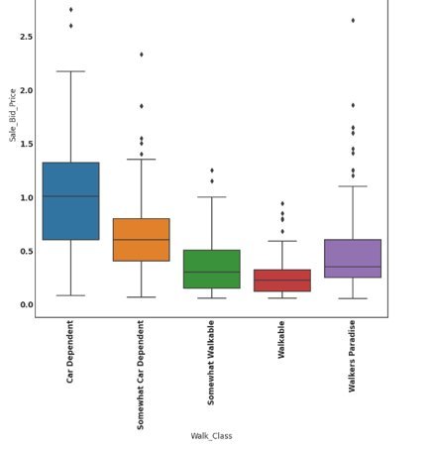
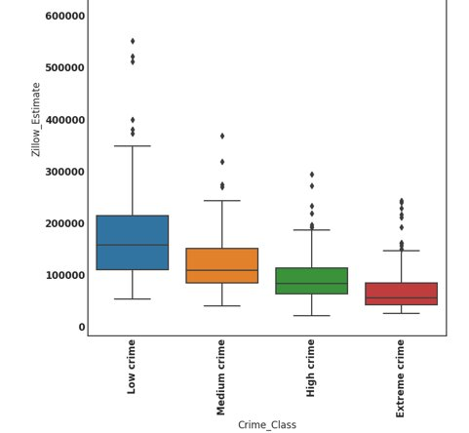
Findings
Walk Score is a statistically significant variable in the regression analysis.​
Overall, there is a negative correlation between walk score and house prices.​
For walk class with highest walk scores (walkers paradise), house prices are seen to be high.​
Negative correlation observed between crime rates in the region and house prices.​
Reject the hypothesis - "An increase in neighborhood´s walkability will lead to an increase in house prices in absence of other factors."

Slide 12

Interesting Finding!
Give preference to living in walkable areas
Live in safe crime-free areas

Slide 13
Recommendations
Would not recommend using model to start a real estate business. Error is around 20% of the average home price.​
Look deeper into the negative relationship between walk score and other features​
Gather data from other large cities and compare results.

Slide 14
References
https://www.americantrails.org/resources/walking-the-walk-how-walkability-raises-home-values-in-u-s-cities ​
https://nacto.org/docs/usdg/walking_the_walk_cortright.pdf ​
https://conservancy.umn.edu/bitstream/handle/11299/187840/JTLU_vol10no1_pp241-261.pdf?sequence=1 ​
https://uppereastriver.com/why-walkability-is-so-important-for-property-investments-and-how-to-measure-that-walkability/ ​
https://www.forbes.com/sites/axiometrics/2016/02/15/high-walkability-may-mean-higher-rent/?sh=5268a4f94536 ​
https://scholarsbank.uoregon.edu/xmlui/bitstream/handle/1794/10386/SustDataAnalysis_ReportOpt.pdf?sequence=1 ​
https://www.redfin.com/news/how-much-does-walkability-increase-home-values/ ​
http://www.u.arizona.edu/~gpivo/Walkability%20Paper%20February%2010.pdf ​
https://www.mdpi.com/2071-1050/12/2/593 ​
https://www.mehrnazamiri.com/project/2020-11-18-walkability/ ​
https://www.loopnet.com/learn/understanding-your-propertys-walk-score-/1309636409/ ​
https://www.jstor.org/stable/24860580#metadata_info_tab_contents​.

Slide 15
Thank You

